Slide 1
Reinforcement Learning in Logistics – A Warehouse Management Case Study
David Middelbeck | Head of Product | Westphalia DataLab GmbH
Marcus Cramer | Head of Analytics | Westphalia DataLab GmbH

Slide 2
WHAT IS REINFORCEMENT LEARNING?
Prediction

Slide 3
Reinforcement Learning – Just a fancy phrase for supervised learning?
State
Action
…
…
Predict the optimal action

Slide 4
Shortcomings of traditional machine learning
Big
Data
Human Biases
How to label data correctly?
How to label data?

Slide 5


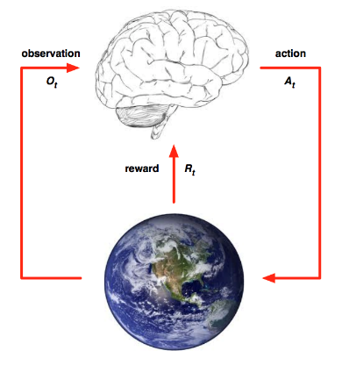
Reinforcement learning – Evolution in silicon
How does evoluation work?
How does reinforcement learning work?
Development + tuning
Evolution
Learning
Learning
Image sources: http://www.effectiveengineer.com/blog/five-key-skills-of-successful-programmers, UCL course on RL

Slide 6
Key difference between reinforcement learning and supervised learning
Label data
Define world
Train
Train
Profit
Profit

Slide 7
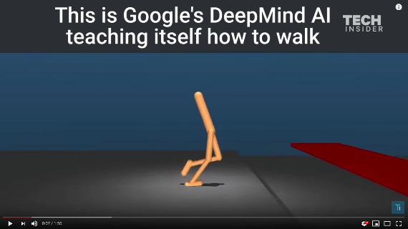
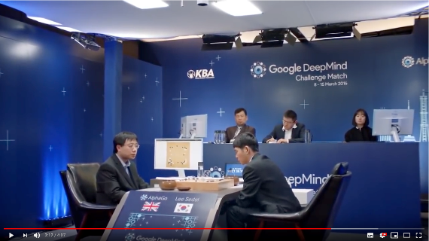
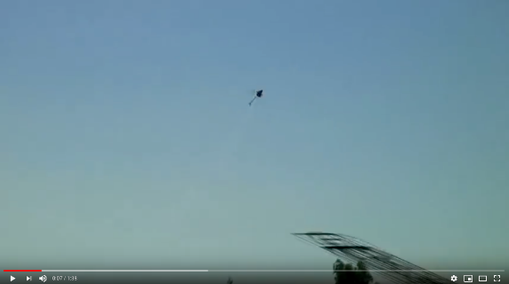
EXAMPLES OF RL USAGE
RL qualifies as a solution method for different kinds of problems
Natural Movement
Complex Games
Autonomous transportation
https://www.youtube.com/watch?feature=oembed&v=gn4nRCC9TwQ
https://www.youtube.com/watch?feature=oembed&v=HT-UZkiOLv8
https://www.youtube.com/watch?feature=oembed&v=VCdxqn0fcnE

Slide 8

A PRACTICAL EXAMPLE
Windy Gridworld: Reach the goal G asap starting in S
The state is given by the actual position on the grid
An action is given by a movement in one of the 4 directions
Entering a field with a small arrow moves the agent one step upward, 2 steps for the big arrows
You cannot leave the grid
The Agent shall be punished for taking too many steps
Reward per step = -1

Slide 9




Approach 1: Determine state values and go to the best next state
Value Function
-10
-9
-8
-7
-19
-18
-17
-11
-6
-20
-16
-12
-5
-21
-15
-13
-4
-14
-3
0
-2
-1

Slide 10
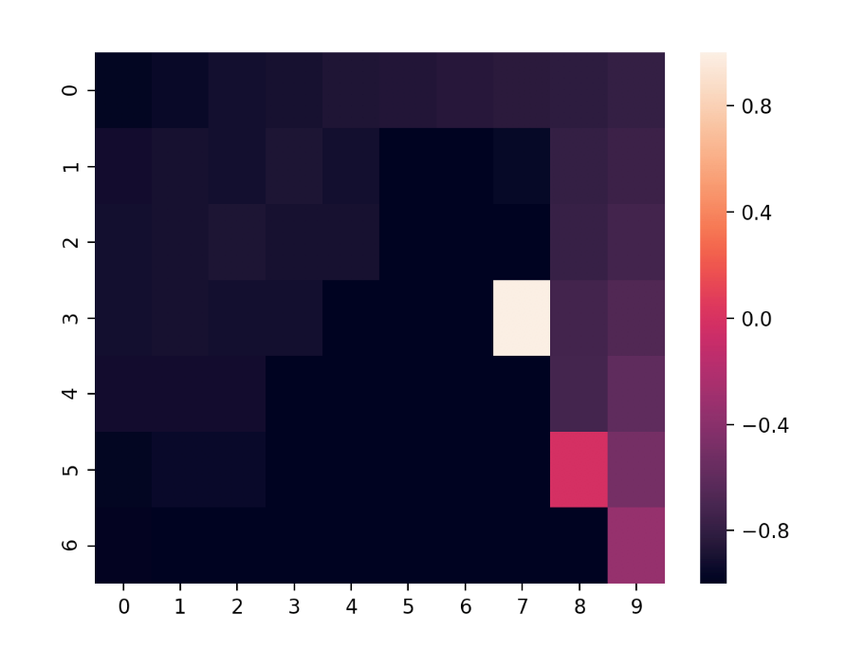
Approach 1: Determine state values and go to the best next state
State values after 1000 iterations

Slide 11
Approach 2: Determine best actions (= policy) directly
Policy function
-2
-4
-1
-3

Slide 12
Live Demo
Try it at home!
https://github.com/MarcusCramer91/WindyGridworld

Slide 13
CHALLENGES IN REINFORCEMENT LEARNING
Source: Google Images

Slide 14





EXAMPLE PROJECT
Incoming Delivery
Outgoing Delivery
Central Warehouse
Shuttle-Traffic
Outer Warehouses

Slide 15






PROCESS OF WAREHOUSING OPTIMIZATION
Input Data
Reinforcement Learning
Warehousing - Recommendation
Historical ingoing and outgoing deliveries
WDL Optimization
Stochastic Simulation of ingoing and outgoing deliveries
Modeling of warehouse-state (e.g. stock) as environment
Usage of Reinforcement Learning, to “learn“ from historical ingoing and outgoing deliveries
Integration of premises to restrict the solution space
Rating of possible warehousing-strategies
Historical stock-streams
Visualization of warehouse-state
Product information
Visualization of stock-streams
Warehouse information
…more…

Slide 16
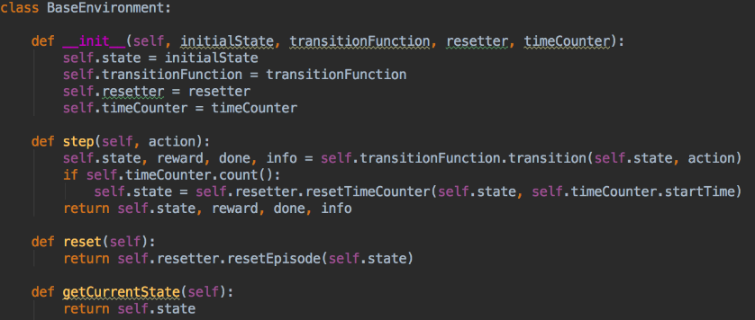
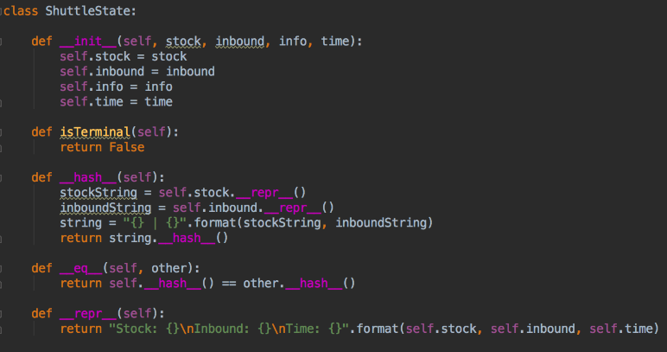
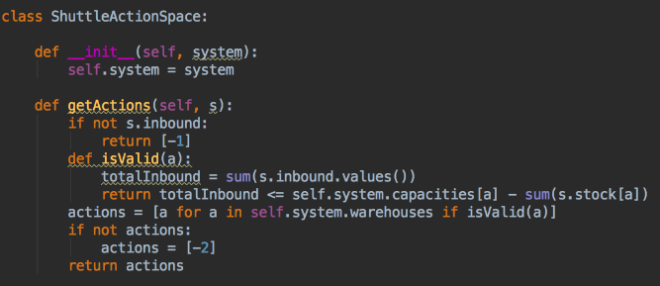
A LITTLE BIT OF CODE…

Slide 17
RL CHALLENGES IN ACTION
Huge State Space:
The huge amount of possible states makes the problem extremely complicated
Local Optima:
If the problem of “Exploration vs. Exploitation“ is not solved well, the algorithm tends to stay in a local optimum
States in general:
A good representation of the problem in the states is essential for the algorithms success. Not having enough information hurts the algorithms knowledge, while having insufficient information increases complexity unnecessary
Time:
As for all projects, time is one of the most important factors, especially if you want to apply RL

Slide 18
Starting points for the interested scholar
Excellent lecture of David Silver (DeepMind) on the topic
https://www.youtube.com/watch?v=2pWv7GOvuf0&list=PL7-jPKtc4r78-wCZcQn5IqyuWhBZ8fOxT
Library with lots of test problems (e.g. ATARI games)
https://gym.openai.com/
Library with lots of implemented RL algorithms
https://tensorforce.readthedocs.io/en/latest/

Slide 19
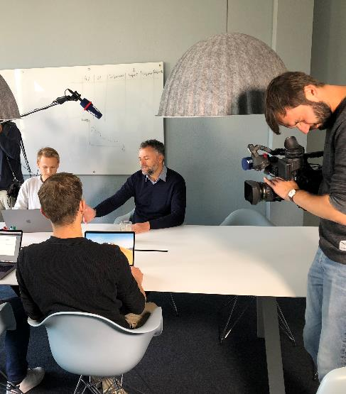

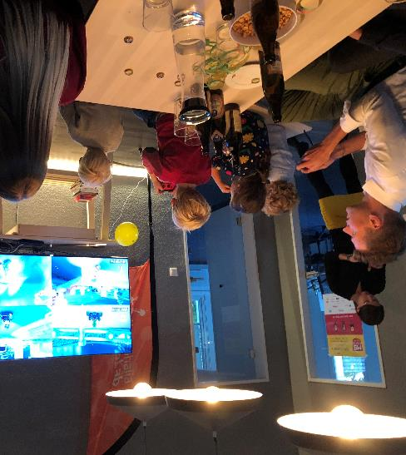
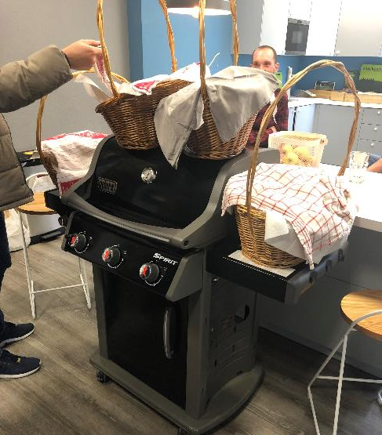

Connect with US @WDL!
David Middelbeck (Head of Product)
+49 151 689 698 85
middelbeck@westphalia-datalab.com
…Or at:
Marcus Cramer (Head of Analytics)
49 (0)151 689 698 79
cramer@westphalia-datalab.com

Slide 20
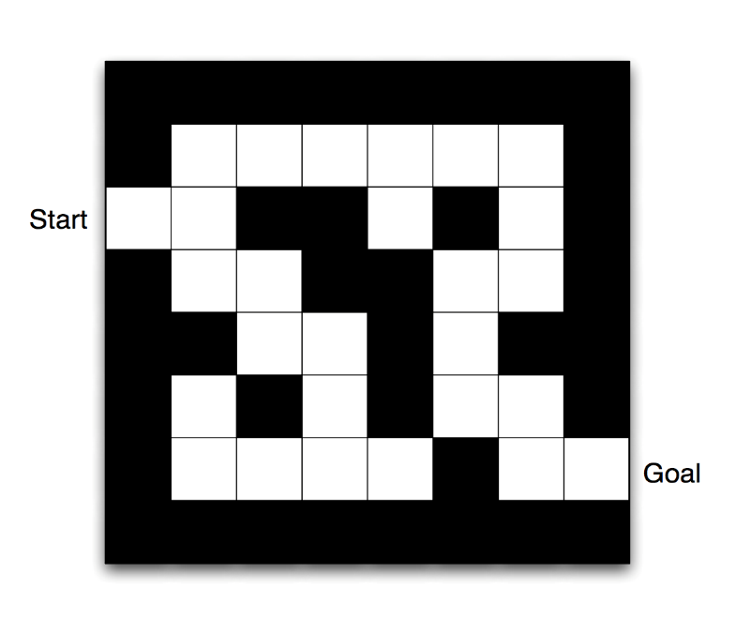
THE GRIDWORLD EXAMPLE
Reach the goal asap
The state is given by the actual position on the grid
An action is given by a movement in one of the 4 directions
The Agent shall be punished for taking too many steps
Reward per step = -1
Source: UCL course on RL
Notes:
-If we want to apply RL to a problem we need to translate the problem into a computational representation
-Our RL Agent must be able observe its actual state, take actions and be rewarded for taking certain actions
-Lets say we want to reach the goal in the Gridworld on the right, using the smallest amount of steps
-The state is given by the actual position of the agent (all possible positions/observations build the observation space the agent is moving in)
-An action is given by a direction in which the agent tries to move to another square (all possible the actions/ the action space is up, down, left and right)
-Since we want to reach the goal asap we need to punish the Agent for taking too many steps, therefore a reward of -1 per action fits our problem

Slide 21
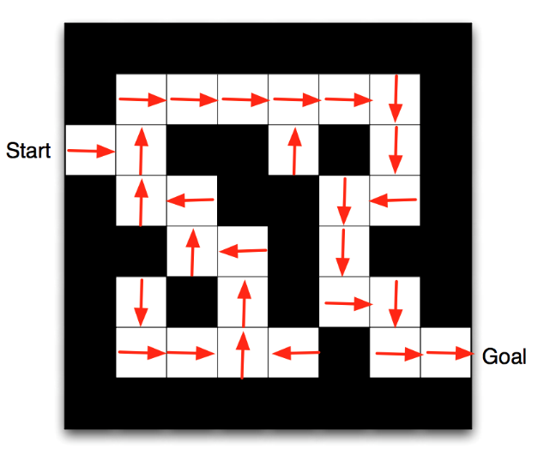
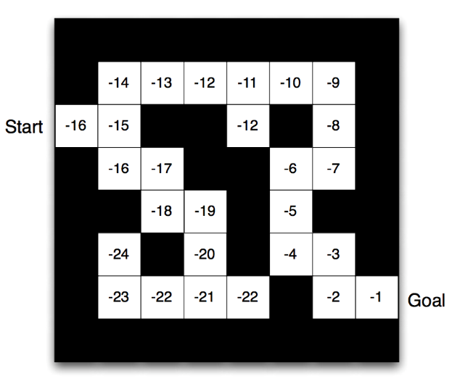
MAJOR COMPONENTS OF THE AGENT
Policy
Value Function
The optimal policy gives us the best action for each state
Expected reward for each state considering usage of the optimal policy
Source: UCL course on RL
Notes:
-The basic structure of the computational representation we have seen before is used to create a model, a policy and a value function. These components are necessary to optimize the Agents decision making
-The Agents representation of the environment is given by the model
-The policy builds the Agents behavior function, it maps states to actions
-The value function evaluates each state and its corresponding actions, therefore it is depending on the policy.
-To optimize the Agents decision making two major components are necessary: The policy, the Agents behavior function, which maps states to actions The value function which evaluates each state depending on the policy
-If the optimal policy is known the problem is solved

